Slide 1

PREDICTING CUSTOMER BUYING BEHAVIOR
08/07/2024

Slide 2
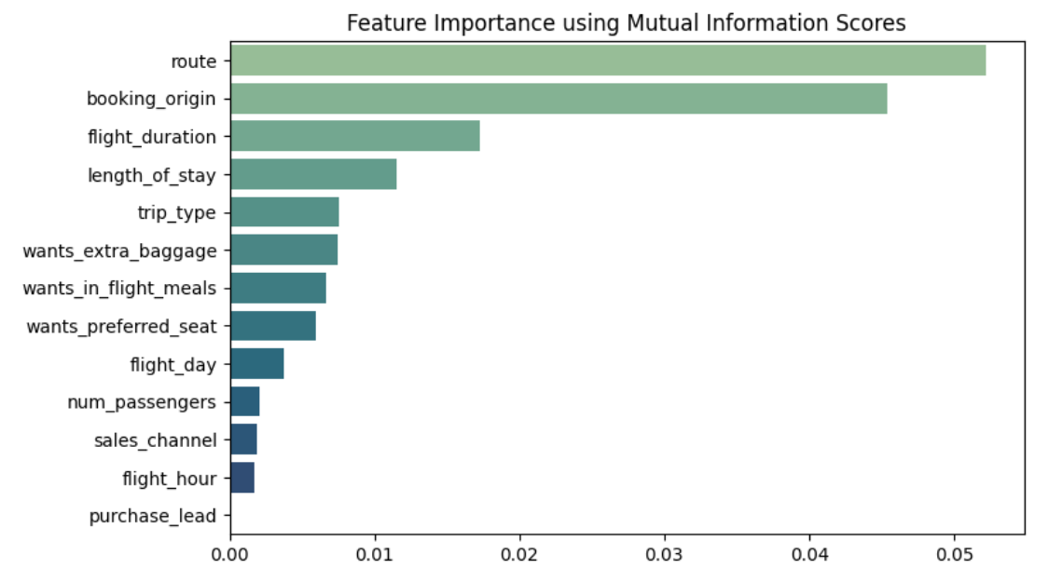
PREDICTIVE MODEL TO UNDERSTAND FACTORS THAT INFLUENCE BUYING BEHAVIOR
We have trained the data set with Random Forest Classifier model and received
Training Accuracy: 99.98
Validation Accuracy: 85.17
Top 5 features which influence
Customer buying behavior:
route
booking_origin
flight_duration
length_of_stay
trip_type

